Slide 1
Class Imbalance and Quantification
Sussex Data Analysis Forum
David Spence
2nd August 2016

Slide 2
Contents
Class imbalance
Example
Measure
Potential solutions
Quantification

Slide 3
The Problem
Classifier loss functions tend to accentuate class imbalances

Slide 4
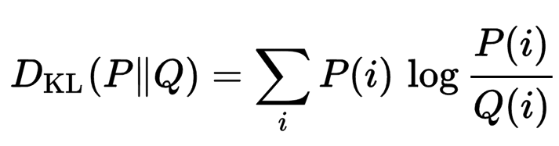
Kullback–Leibler divergence
Standard measure of class imbalance
A measure of difference between two probability distributions P and Q
Also known as Cross-Entropy

Slide 5
Solutions
Weighting / over-sampling
Under-sampling
Synthetic oversampling (SMOTE)

Slide 6
SMOTE
Synthetic
Minority
Over-sampling
TechniquE

Slide 7
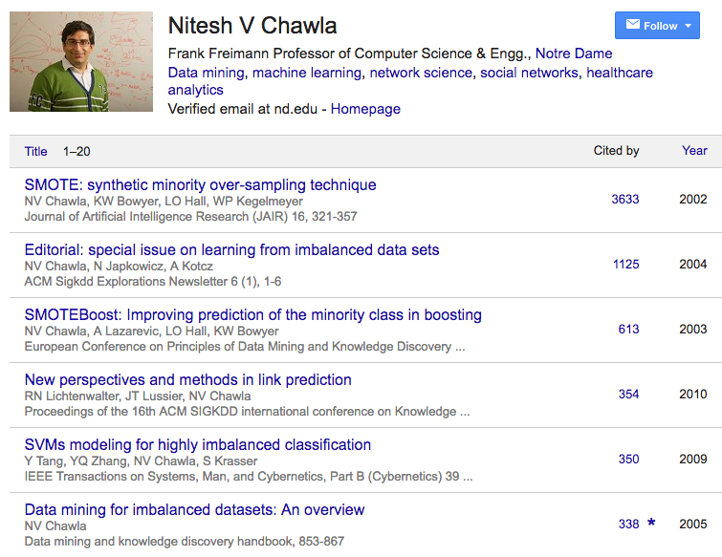

Slide 8
SMOTE
Find n nearest neighbours – of any class
Generate a synthetic datapoint from each parent-neighbour pairing

Slide 9
No SMOTE
SMOTE

Slide 10
Accuracy vs. KL-Divergence

Slide 11
Macro-F1 score vs. KLD

Slide 12
Quantification
Count by class in total
NOT classification of each instance
Very common
Just count the classifier output?

Slide 13
100%
True Value
Classifier Output
Classifier Output Prevalence
true positive rate
false positive rate
0%
0%
True Prevalence
100%
Test Set True Prevalence

Slide 14
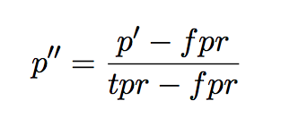
Foreman Adjusted Count
“Quantifying counts and costs via classification”
Forman, George
Data Mining and Knowledge Discovery
2008

Slide 15
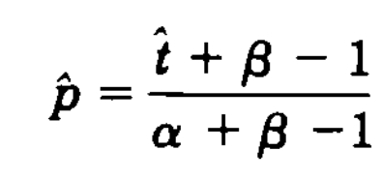
Rogen and Gladen
“Estimating prevalence from the results of a screening test”
Rogan, Walter J and Gladen, Beth
American journal of epidemiology
1978

Slide 16
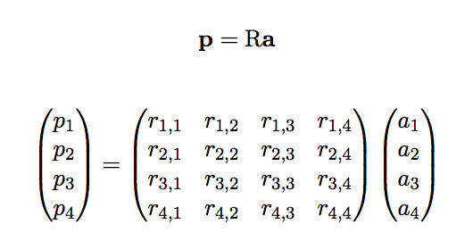
Inverse Problem
Inverse Problem
p_{val} = R_{val}.a_{val}
p_{te} = R_{te}.a_{te}
…
a_{te} ~ (R_{val})⁻¹.p_{te}
Potential for noise
Condition Number of R

Slide 17
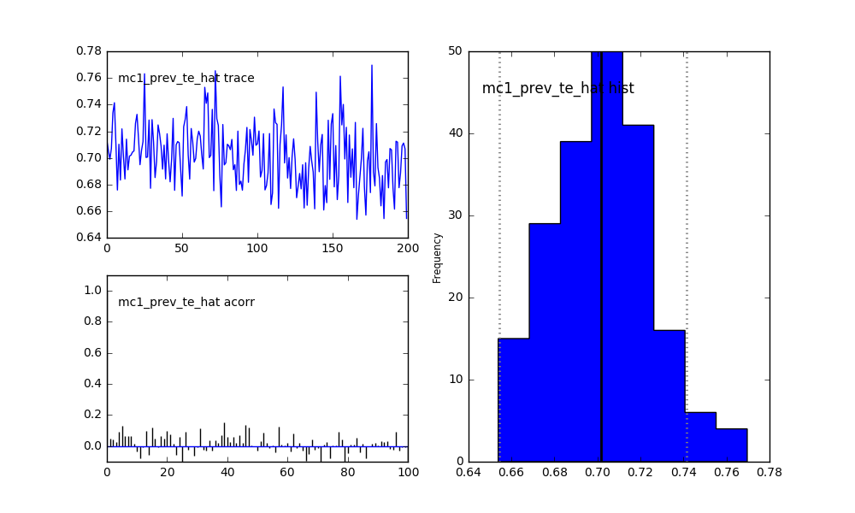
McMC with PyMC
Probability distributions for latent variables

Slide 18
Contents
Class imbalance
Example
Measure
Potential solutions
Quantification

